Slide 1
YOLO Implement
배정준

Slide 2
YOLO Implement
darknet YOLO
colab
pyTorch YOLO
https://www.youtube.com/watch?v=n9_XyCGr-MI

Slide 3
darknet YOLO
** GPU 사용하기 **
# change Makefile GPU = 1
# uncomment ARCH
# NVCC=/usr/local/cuda/bin/nvcc
** 경로 알맞게 수정하기 **
#cfg/voc.data
#classes= 20
#train = train.txt
#valid = 2007_test.txt
#names = data/voc.names
#backup = backup
# examples/yolo.c
# char *train_images = "train.txt";
# char *backup_directory = "backup";
# list *plist = get_paths("2007_test.txt");
!make

Slide 4
pyTorch YOLO
20
25
29
0
Predictions
C₁ C₂ C₂₀ P_{c1} x y w h P_{c2} x y w h
targets
C₁ C₂ C₂₀ P_{c} x y w h

Slide 5
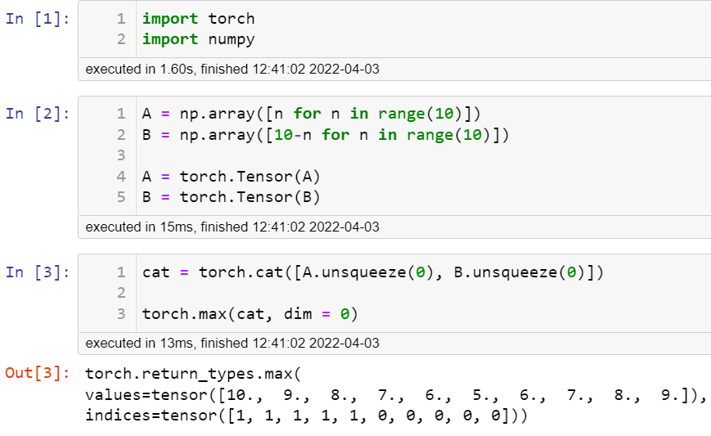
pyTorch YOLO
torch.max
[0, 1, 2, 3, 4, 5, 6, 7, 8, 9]
[10, 9, 8, 7, 6, 5, 4, 3, 2, 1]

Slide 6
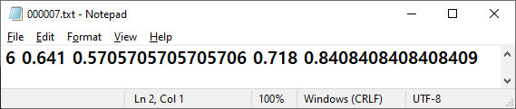
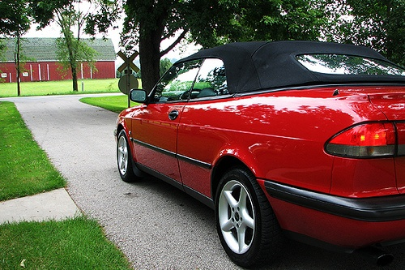

pyTorch YOLO
$$1_{i}^{obj}$$
0 | 0 | 0 | 0 | 0 | 0 | 0
0 | 0 | 0 | 0 | 0 | 0 | 0
0 | 0 | 0 | 0 | 0 | 0 | 0
0 | 0 | 0 | 0 | 1 | 0 | 0
0 | 0 | 0 | 0 | 0 | 0 | 0
0 | 0 | 0 | 0 | 0 | 0 | 0
0 | 0 | 0 | 0 | 0 | 0 | 0

Slide 7



